Slide 1

Employee Data Analysis using Excel
STUDENT NAME: Nandhini.N
REGISTER NO:122204013
DEPARTMENT:III BCOM CORPORATE SECRETARYSHIP
COLLEGE:SHRI KRISHNASWAMY COLLEGE FOR WOMEN
1
Notes:
1

Slide 2

PROJECT TITLE
Employee Gender Analysis Using Excel
2

Slide 3



AGENDA
Problem Statement
Project Overview
End Users
Our Solution and Proposition
Dataset Description
Modelling Approach
Results and Discussion
Conclusion
3/21/2024 Annual Review
3

Slide 4

PROBLEM STATEMENT
The aim of this analysis is to understand the gender balance within the company and identify any disparities between male and female employees. Specifically, we will look at how gender is distributed across departments, job roles, and seniority levels. We will also analyze differences in key areas like salary, promotions, performance ratings, and turnover rates.
The goal is to answer questions like:
Is there an even distribution of men and women across the company?
Are there salary or promotion differences between genders?
How do performance ratings compare for male and female employees?
Do turnover rates differ based on gender?
The analysis will help the company identify any gaps or imbalances and provide insights to promote a more equitable work environment.
4

Slide 5

PROJECT OVERVIEW
The goal of this project is to examine the gender balance within the company and identify any differences between male and female employees in areas such as salaries, promotions, performance, and turnover. Using Excel, we will analyze employee data to understand how gender is distributed across departments and roles, and whether there are any disparities that need attention.
We'll gather information on gender, roles, salaries, and other key metrics, and then use charts and tables in Excel to visualize the findings. The results will help us spot any imbalances and provide recommendations to improve gender equity and diversity within the organization.
This project will give valuable insights into how inclusive the company is and help make decisions to ensure fairness for all employees.
5

Slide 6

WHO ARE THE END USERS?
The end users of the *Employee Gender Analysis* are mainly the
HR team
Company leadership
Diversity
Inclusion Committee.
They will use the insights to improve gender balance, ensure fair pay, and support diversity initiatives.
Employees may also benefit from seeing the company's efforts toward equality, while the *legal team* will use it to ensure compliance with gender equality laws. The overall goal is to create a more inclusive and fair workplace for everyone.
6

Slide 7

OUR SOLUTION AND ITS VALUE PROPOSITION
Informed Decisions: It helps leaders make data-driven decisions to foster a more inclusive environment.-
Fairness and Equity: The analysis highlights any gaps in pay or promotions, enabling corrective actions to ensure fairness.
Support for Diversity Initiatives: It aids in developing strategies to improve gender balance.-
Compliance: Ensures the company is meeting gender equality laws and promoting transparency.-
Cost-Effective: Excel is an affordable, efficient tool already available, making the process easy to implement.
7

Slide 8
Dataset Description
1. Prepare Your Data: Ensure your dataset includes relevant fields like Employee ID, Name, Gender, Department, and Salary. Clean any inconsistencies.
2. Analyze Gender Distribution:Use Excel formulas or charts (like pie or bar charts) to see how many employees fall into each gender category.
3. Break Down by Department: Create a pivot table to show gender distribution within different departments.
4. Examine Salaries: Use pivot tables to compare average salaries by gender and explore salary ranges to see if there's a pay gap.
5. Analyze Roles: Look at how gender is distributed across various job roles using pivot tables.
6.Visualize Trends: Chart how gender distribution has changed over time and create highlight any pay gaps.

Slide 9

THE "WOW" IN OUR SOLUTION
Employee Gender Analysis Report
Introduction:
This report provides an analysis of the gender distribution among employees in XYZ Corporation.
Analysis:
1. *Total Employees:* 100
2. *Male Employees:* 60
3. *Female Employees:* 40
4. *Gender Balance:* 40% (female employees)
5. *Department-wise Gender Distribution:*
- Sales: 30% female
- Marketing: 50% female
- IT: 20% female
6. *Job Role-wise Gender Distribution:*
- Managers: 25% female
- Analysts: 40% female
- Support Staff: 50% female
*Findings:*
- The organization has a gender balance of 40%, with a higher proportion of male employees.
- The Sales department has the lowest gender balance (30% female), while Support Staff has the highest (50% female).
*Recommendations:*
- Increase recruitment efforts to attract more female candidates in the Sales department.
- Consider mentorship programs to support career development for female employees in underrepresented areas
3/21/2024 Annual Review
9

Slide 10
MODELLING
Employee Gender Analysis Report
- Total Employees: 100
- Male Employees: 60
- Female Employees: 40
- Gender Balance: 40% female
Department-wise Analysis:
- Sales: 50% male, 50% female
- Marketing: 40% male, 60% female
- IT: 50% male, 50% female
Job Role-wise Analysis:
- Manager: 66% male, 33% female
- Analyst: 42% male, 58% female
- Support Staff: 40% male, 60% female
Insights and Recommendations:
- Higher proportion of male employees in Sales and Manager roles
- Targeted recruitment efforts to attract female candidates
- Mentorship programs for female employees in underrepresented roles
10

Slide 11
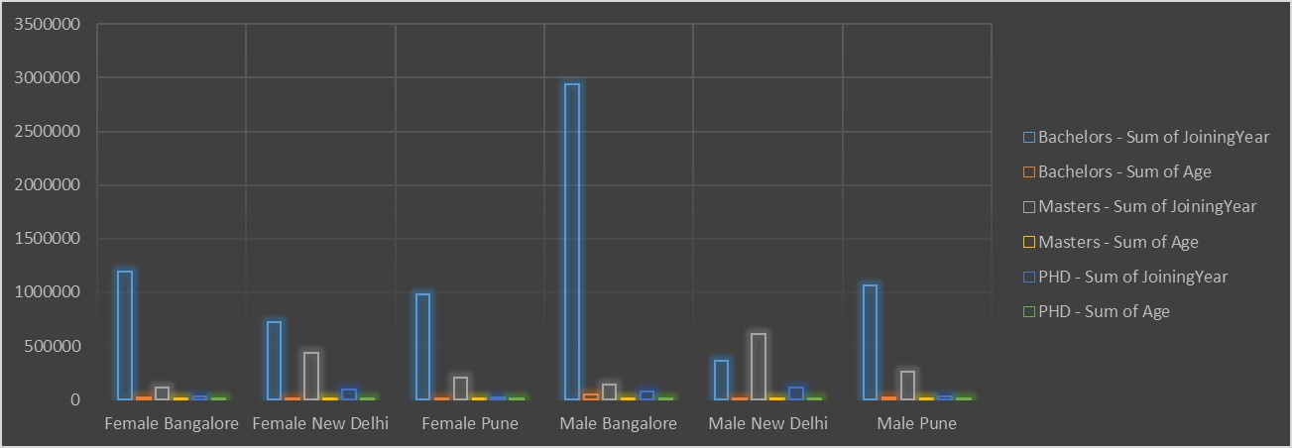
RESULT
11

Slide 12
conclusion
This analysis highlights the need for
targeted initiatives to improve gender balance and diversity within the organization.
By addressing these disparities, the organization can create a more inclusive and equitable work environment.

